Slide 1


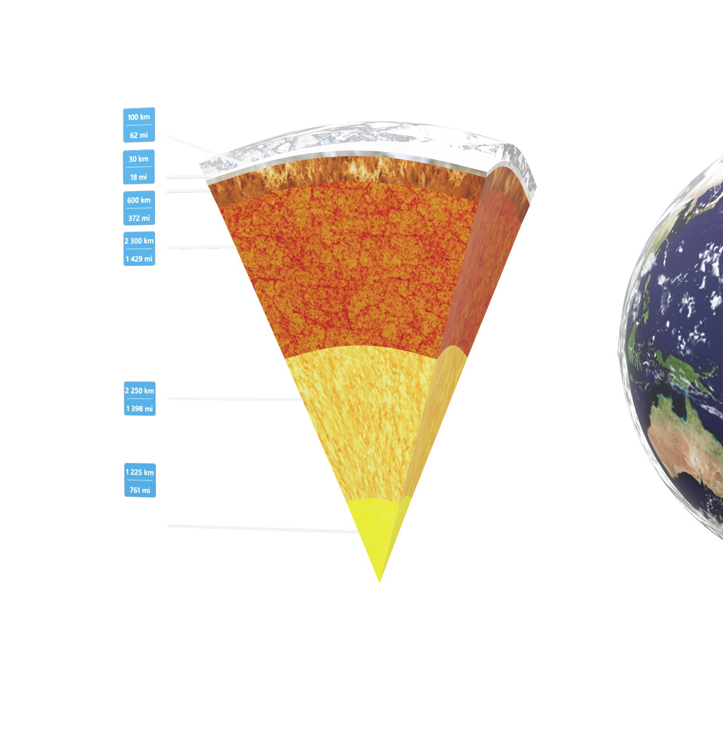
Duration: 95 min
High School
Grade: 9 -12
CCSS, NGSS
Plate tectonics
Geology
Click on the model to interact

Slide 2

Lesson overview
The topic of plate tectonics is largely based on Alfred Wegner's theory of continental drift, which became accepted with the discovery of seafloor spreading in the Atlantic Ocean, and after fossil, flora, and geological studies in Africa and South America. In this lesson, students will learn about Earth’s structure, differences between various types of tectonic plate boundaries, their outcomes, and their connection to locations of volcanoes and earthquake activity.
.
Learning objectives
Describe the general distribution of fold mountains, volcanoes, and earthquakes, and explain how this distribution is related to movements at plate boundaries.
Show a basic understanding of plate tectonics, describe the global pattern of plates and their structure, and be aware of plate movements and their effects – constructive (plates moving away from each other), destructive (plates moving towards each other), and conservative (plates sliding past each other).
Demonstrate an understanding of the main features of volcanoes (and their eruptions) and earthquakes.
Keywords
Plate Tectonics, Lithospheric Plates, Boundary, Divergent Boundary, Convergent Boundary, Sea-floor Spreading, Continental Crust, Oceanic Crust, Continental Drift, Pangea, Volcano.

Slide 3
Standards
Common Core
CCSS.ELA-Literacy SL.9-10.1
Initiate and participate effectively in a range of collaborative discussions (one-on-one,
in groups, and teacher-led) with diverse partners on grade 9-10 topics, texts, and issues, building on others' ideas and expressing their own clearly and persuasively.
CCSS.ELA-Literacy SL.11-12.5
Make strategic use of digital media (e.g., textual, graphical, audio, visual, and interactive elements) in presentations to enhance understanding of findings, reasoning, and evidence, and to add interest.
NGSS
HS-ESS1-5.
Evaluate evidence of the past and current movements of continental and oceanic crust and the theory of plate tectonics to explain the ages of crustal rocks.
HS-ESS2-1.
Develop a model to illustrate how Earth’s internal and surface processes operate at different spatial and temporal scales to form continental and ocean-floor features.
MS-ESS2-3.
Analyze and interpret data on the distribution of fossils and rocks, continental shapes, and seafloor structures to provide evidence of the past plate motions.

Slide 4

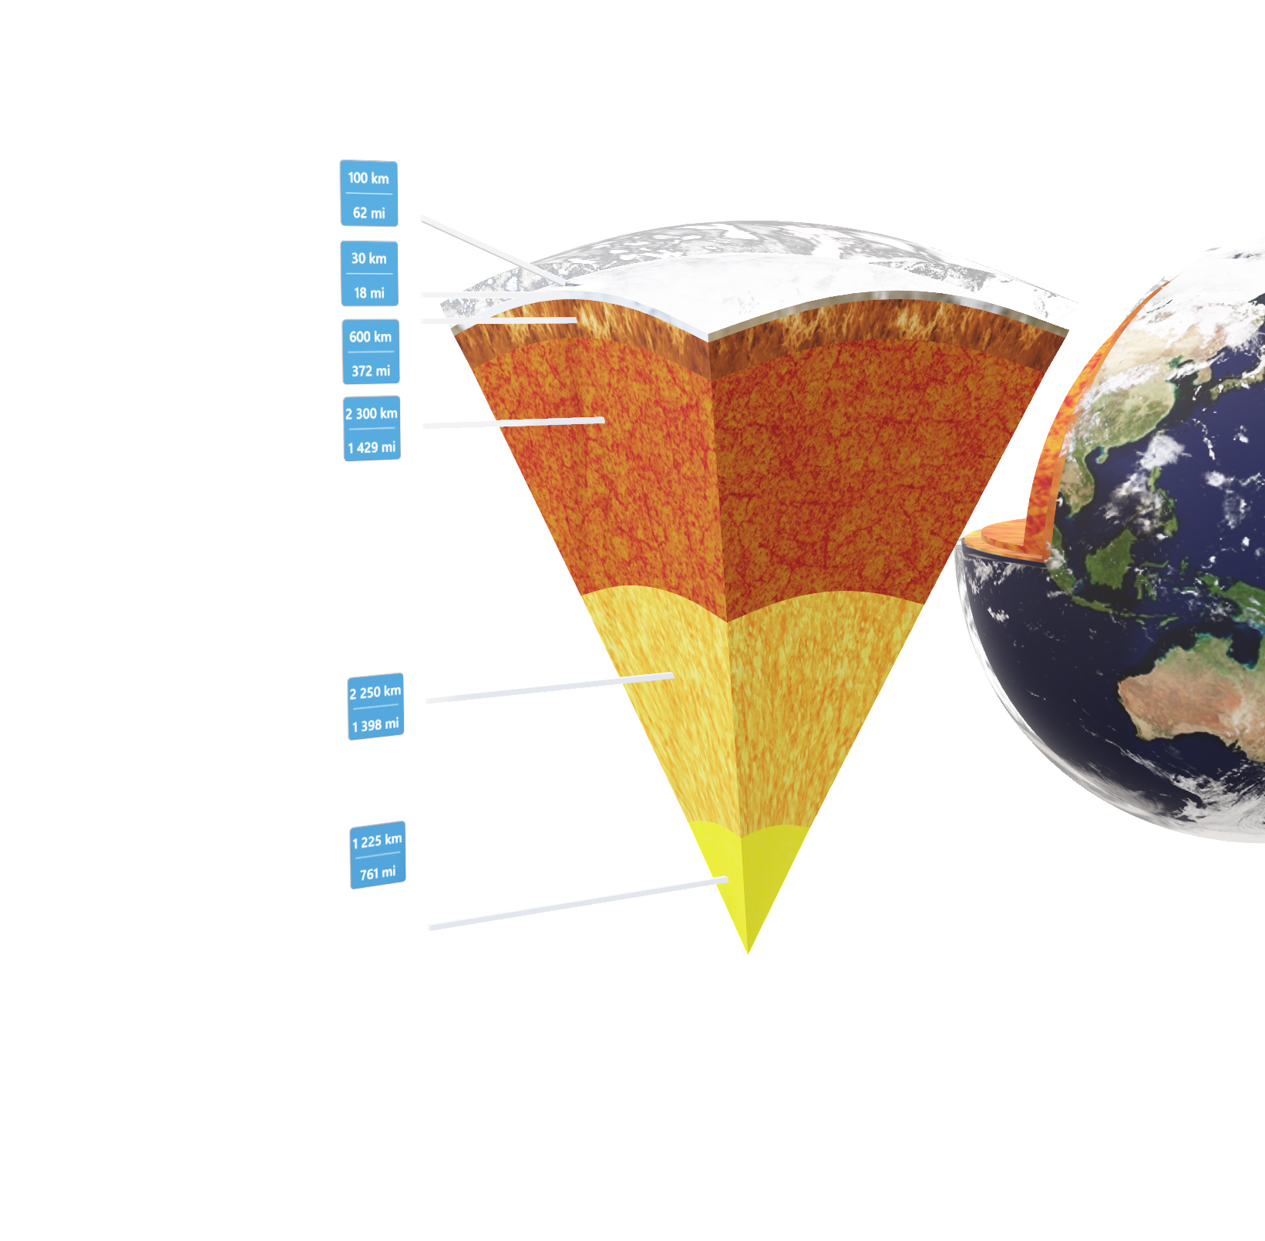
1. Introduction to Earth Structure
10
min
Explain to your students the structure of the Earth by highlighting and speaking about different layers on the Lifeliqe model.
Open the Lifeliqe app and enter “Earth” or “Structure of the Earth” into the search box.
Open the model and highlight the “Earth - V cut” part and its components, including measure, and read the Introduction section:
Atmosphere - the layer of gases, commonly known as air, that surrounds the planet Earth and is retained by Earth's gravity. The atmosphere protects life on Earth by absorbing ultraviolet solar radiation, warming the surface through heat retention (the greenhouse effect), and reducing temperature extremes between day and night.
Crust - the outermost layer of the earth, 3–44 miles (5–70 km) thick and representing less than 1% of the earth's total volume.
Upper Mantle - The upper mantle begins just beneath the crust and ends at the lower mantle. The thickness of the upper mantle is between 200 and 250 miles (320-400 km). The temperature of the mantle near the crust ranges from 900 to 1600 degrees Fahrenheit (480-870 °C).
Lower Mantle - The entire mantle is about 1,800 miles (2900 km) thick, which means that the lower mantle makes up the bulk of this part of the Earth. It gets hotter at greater depths. The lower mantle near the core is as hot as 7000 degrees Fahrenheit (3870°C).
Fluid Core - The outer core of the Earth is a fluid layer about 1,400 miles (2300 km) thick and composed of iron and nickel.
Solid Core - The inner core is Earth's innermost part and according to seismological studies, it has been believed to be primarily a solid ball with a radius of about 1220 kilometers, or 760 miles. It is composed of an iron–nickel alloy and some light elements. The temperature at the inner core boundary is approximately 9800 degrees Fahrenheit (5400 °C).
Click on the model to interact

Slide 5
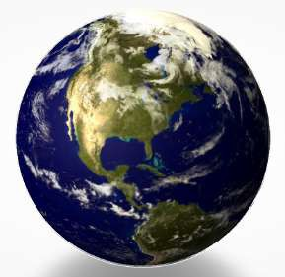
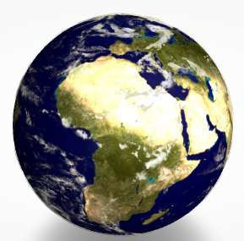
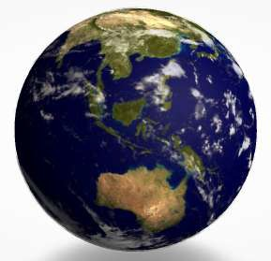
2. Lithospheric plates
15
min
Lithospheric plates are regions of Earth's crust and upper mantle that are fractured into plates that move across a deeper plasticine mantle. Earth's crust is fractured into 13 major and approximately 20 total lithospheric plates. Each lithospheric plate is composed of a layer of oceanic crust or continental crust on top of an outer layer of the mantle. Containing both crust and the upper region of the mantle, lithospheric plates are generally considered to be approximately 60 mi (100 km) thick.
The dynamics of plate tectonics, driven by deeper thermal processes, stress and cause elastic strain on lithospheric materials. The resulting fractures of rock in the lithosphere cause a release of energy in the form of seismic waves (i.e., an earthquake).
Open the model of Earth in the Lifeliqe app, print out pictures of the surface, and distribute them among students (or just show the major boundaries on the model):
Click to open in Lifeliqe

Slide 6
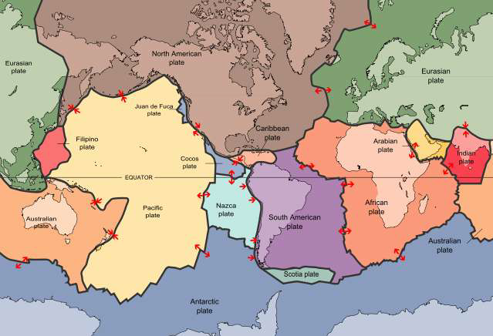
Let the students draw in their copies the major lithospheric plates as shown in the picture here:
Map: USGS Description: Scott Nash, Plates tect2 en, marked as public domain, more details on Wikimedia Commons

Slide 7
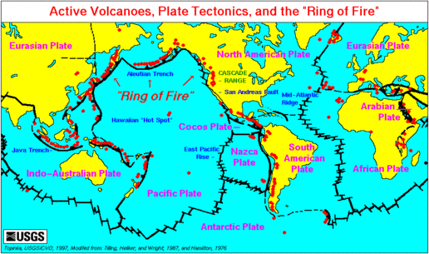
3. Oceanic v. continental crust, plate boundaries and volcanoes
15
min
There are two types of crust, oceanic and continental. Oceanic crust is generally found under the oceans and continental under land. Although plates are usually a combination of oceanic and continental crust, there are some key differences between the two types of crust:
The oceanic crust is 3 mi (5 km) to 6 mi (10 km) thick, and is composed primarily of basalt, diabase, and gabbro. The age of the oldest oceanic crust today is only about 200 million years.
The continental crust is typically from 20 mi (30 km) to 30 mi (50 km) thick, and is mostly composed of slightly less dense rocks than those of the oceanic crust. The present average age of Earth's continental crust has been estimated to be about 2.0 billion years.
The location where two lithospheric plates meet is called a plate boundary. Plate boundaries are commonly associated with geological events such as earthquakes and the creation of topographic features such as mountains, volcanoes, mid-ocean ridges, and oceanic trenches. The majority of the world's active volcanoes occur along plate boundaries, with the Pacific Plate's Ring of Fire being the most active and widely known today.
Explore the model of Earth once more and point out the correlation between locations of active volcanoes (according the USGS) and the location of plate boundaries:
USGS, Map plate tectonics world, marked as public domain, more details on Wikimedia Commons

Slide 8
4. Differences between boundaries
20
min
In geological terms, there are three types of boundaries between lithospheric plates. At divergent boundaries, lithospheric plates move apart and crust is created.
At convergent boundaries, lithospheric plates move together in collision zones where crust is either destroyed by subduction or uplifted to form mountain chains. Lateral movements between lithospheric plates create transform faults at the sites of plate slippage. At each of the unique lithospheric plate boundaries there are specific geophysical forces that are characteristic of the plate dynamics. At transform boundaries, there are shearing forces between the lithospheric plates. At divergent boundaries, tensional forces dominate the interaction between plates. At subduction sites, compression of lithospheric plate material dominates.
Now search for the models in the Lifeliqe app: Divergent (Constructive) Boundary, Convergent (Destructive) Boundary and Faults.
Divide the class into three groups and assign one model to each group to study. Write three main points on the board (direction and type of force, what’s happening to the crust, and the results of the activity) to guide their thinking. Let the students observe the models, use the Internet and the texts in the Introduction section, and make Notes directly in the app.
After approx. 10 minutes, let the students present their findings in groups and explain the differences in forces and results in each type of the boundary:

Slide 9
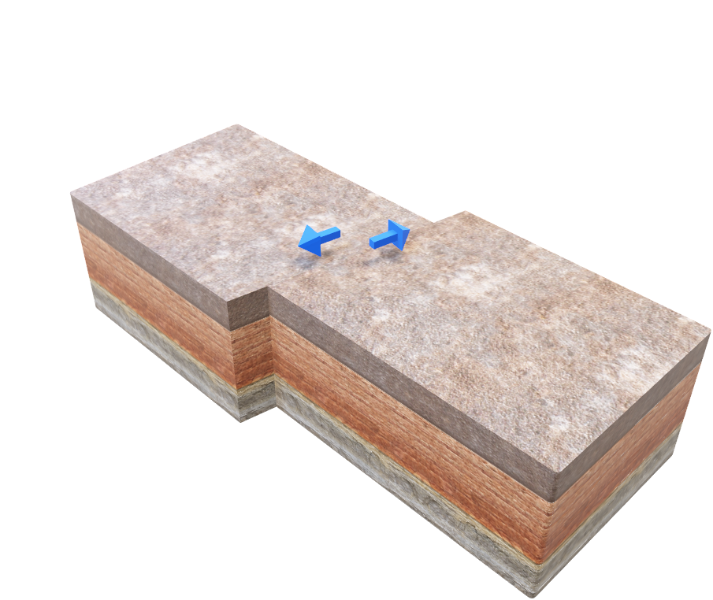
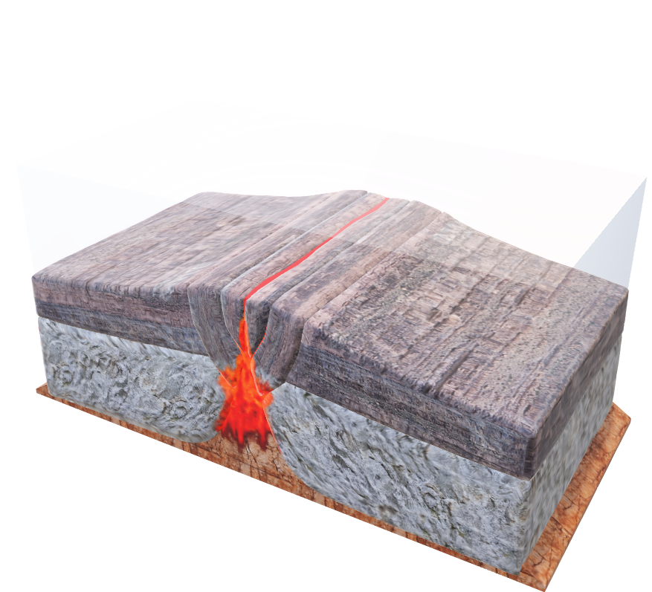
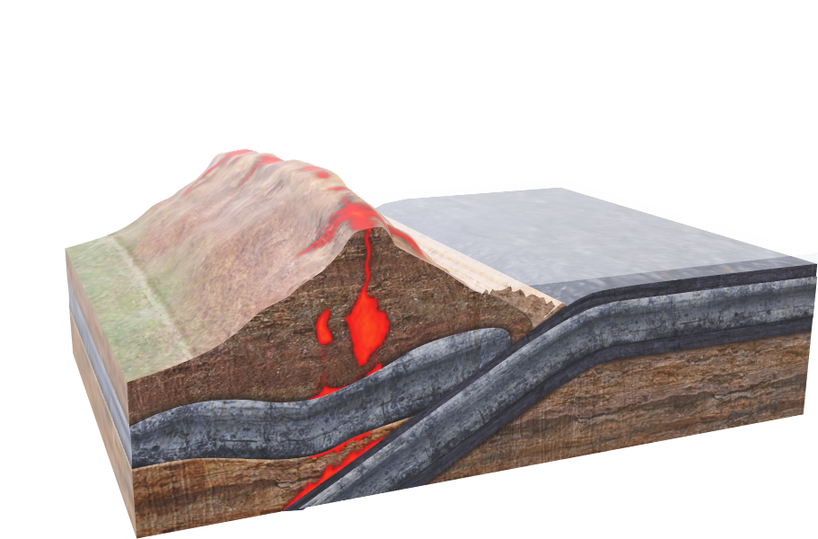
Click on any model to interact
Direction and type of force:
Inwards (converge)
Compressing force
Crust is: created x destroyed x either
Result: one side can be li ed into mountain ranges or volcanoes, the other is usually subducted (oceanic trenches)
Direction and type of force:
Outwards (diverge)
Tensional force
Crust is: created x destroyed x either
Result: Magma can reach the surface and result in for instance seafloor ridge spreading, earthquakes, and tsunamis.
Direction and type of force:
Lateral (horizontal, vertical, at angle)
Shearing force
Crust is: created x destroyed x either
Result: Graben or horst Strike-slip fault Earthquake

Slide 10

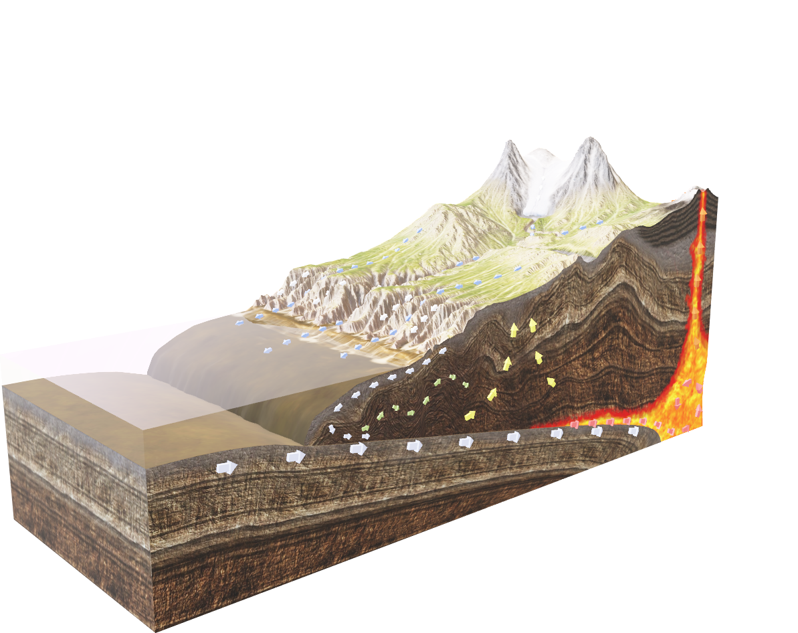
5. Continental drift and convection current theory
10
min
"Doesn't the east coast of South America fit exactly against the west coast of Africa, as if they had once been joined? This is an idea I'll have to pursue."
Alfred Wegener to his future wife, December, 1910.
225 million years ago all the continents are believed to have been joined together in one supercontinent called Pangaea. Over millions of years, convection currents started moving the continents apart until there were two continents, Laurasia and Gondwanaland. Today the continents have moved even further apart, creating the land masses that we know today. The continents have not stopped moving, so in the future the world will look different again, for example Europe and North America are actually moving apart at up to 10cm a year, while North America and Asia are moving closer together.
The tectonic plates are being moved by convection currents found within the mantle of the earth. This is a list of how convection currents work:
Magma (semi-molten rock) near the outer core is heated.
As the magma warms it expands and becomes less dense.
The less dense magma then starts to rise towards the crust.
As the magma nears the crust it begins to cool.
The cooling magma becomes denser and begins to sink.
The rising and falling magma creates circular currents with the mantle.
It is these currents that create friction with the crust above and causes it to move.
Find the Rock Cycle scene in the Lifeliqe app and show the students the movements in Earth’s crust supporting the theory of convection currents - mainly Uplift, Melting of Rocks, Subduction of Tectonic Plate, and Transport and Deposition of Sedimentary Rocks:
Click on the model to interact

Slide 11
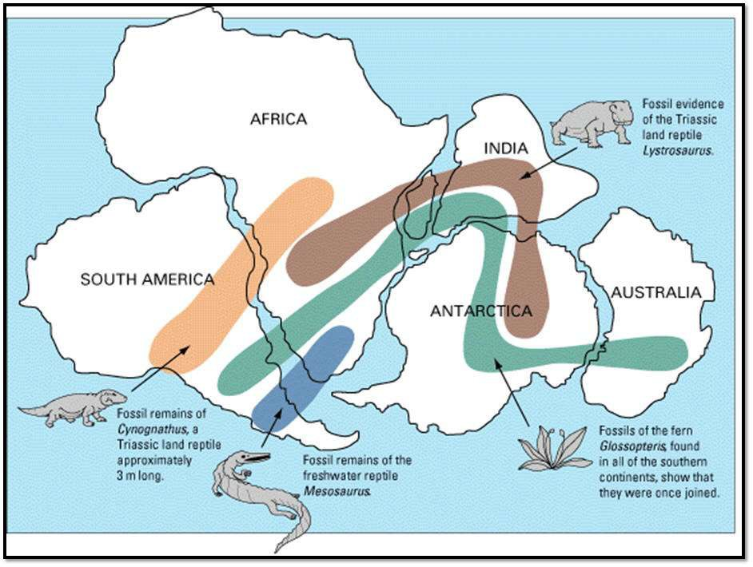
6. Final exercise supporting the Continental drift theory
15
min
Evidence for the movement of continents on tectonic plates is now extensive. Similar plant and animal fossils are found around the shores of different continents, suggesting that they were once joined. The fossils of Mesosaurus, a freshwater reptile rather like a small crocodile, which have been found both in Brazil and South Africa, are one example; another is the discovery of fossils of the land reptile Lystrosaurus in rocks of the same age at locations in Africa, India, and Antarctica.
Another major piece of evidence for the theory of continental drift is the widespread distribution of glacial sediments in South America, Africa, Madagascar, Arabia, India, Antarctica, and Australia.
Take the printouts of the Earth with marked plate boundaries from the previous exercise and let students cut out the continents: North America, South America, Africa/Madagascar, Europe, Asia and India, Australia, and Antarctica. (Or hand out pieces prepared in advance.)
Mark and describe the fossil depositories found on the continents of Africa and Madagascar, South America, Antarctica, Australia, and the Indian peninsula, and show how they used to be connected in the past by moving the cutouts:
Osvaldocangaspadilla, Snider-Pellegrini Wegener fossil map,
marked as public domain, more details on Wikimedia Commons

Slide 12
Further activities
Watch a video about seafloor spreading from Discovery Education bit.ly/28Ko4QV
Browse through the Paleontology section in the Lifeliqe app, find the mentioned prehistoric animals, and take a selfie with them using the AR function.
Explain plate tectonics on a piece of paper (folding v. tearing).

Slide 13
7. Wrap up of the key findings and discussion
10
min
Questions for the discussion:
Do you think there are any signs of life in the mantle, outer core, or inner core layers of Earth? Explain your thoughts.
Why do you think the inner core of Earth is solid?
What is the direction of plate motion at a divergent plate boundary? How does the hot material break through the lithosphere?
What happens at a convergent plate boundary?
What types of plates can meet up at convergent boundaries?
Which plate’s crust dived under the other’s crust and why do you think that happened?
Many places around the edge of the Pacific Ocean experience volcanoes and earthquakes.
Why do you think this happens?
How does seafloor spreading fit into the idea that continents move about on Earth’s surface?

Slide 14

Thanks for using Lifeliqe's lesson plan!
Excite your students in learning science with 1,000+ more 3D models and lesson plans at online.lifeliqe.com

